Slide 1

ICT502
Week 5: Skills and Capabilities in IT Projects
ICT502 Applied IT Project A
1

Slide 2
What we learned last week
Introduction to Modelling
What is UML?
Use case diagrams
Class diagrams
Sequence diagrams
Activity diagrams
Best Practices in Choosing UML Diagrams in IT Projects
Summary

Slide 3
Preparation for Assessment 4
You are NOT just writing a report.
You are:
Acting like an IT consultant
Solving a real business problem (e.g., NSW IT Support)
Designing a real system (proposal for ICT503 next unit)

Slide 4
Preparation for Assessment 4
Think:
“What problem does NSW IT Support actually have, and how can I solve it with IT?”

Slide 5
Preparation for Assessment 4
STEP 0: CHOOSE YOUR PROJECT IDEA
Based on NSW IT Support, common project ideas:
Good project examples:
- IT Helpdesk Ticketing System (very common)
- AI-based customer support chatbot
- Cybersecurity monitoring dashboard

Slide 6
Preparation for Assessment 4
- Cloud-based client management system (CRM)
- Remote IT support automation platform
- IT asset management system
Example we’ll use: “Smart IT Support Ticketing System with AI prioritisation”

Slide 7
Preparation for Assessment 4
STEP 1: UNDERSTAND THE COMPANY (VERY IMPORTANT)
Extract key points from NSW IT Support:
They:
- Provide IT support + cloud + cybersecurity
- Work with SMEs (small businesses)
- Focus on customer service
- Handle daily IT issues

Slide 8
Preparation for Assessment 4
Problem clues:
- Many support requests
- Need fast response
- Need better system efficiency

Slide 9
Preparation for Assessment 4
QUESTIONS YOU SHOULD ASK THE COMPANY
(VERY IMPORTANT for high marks)
About operations:
- How do you currently manage IT support tickets?
- What are the biggest delays in resolving issues?
- Do you use any system (e.g., Jira, ServiceNow)?

Slide 10
Preparation for Assessment 4
About customers:
- What are the most common IT problems?
- How many tickets per day?

Slide 11
Preparation for Assessment 4
About pain points:
- What frustrates customers the most?
- Where do errors happen?

Slide 12
Preparation for Assessment 4
About technology:
- Do you use cloud systems?
- What cybersecurity challenges do you face?

Slide 13
Preparation for Assessment 4
SECTION-BY-SECTION GUIDE (WITH EXAMPLES)
SECTION 1: Executive Summary (250 words)
What to do:
Summarise EVERYTHING in short

Slide 14
Preparation for Assessment 4
Structure:
- Problem
- Solution
- Benefits
- Sustainability

Slide 15
Preparation for Assessment 4
Sample:
NSW IT Support faces challenges in efficiently managing high volumes of IT support requests, leading to delays and reduced customer satisfaction. This project proposes a Smart IT Support Ticketing System integrated with AI-based prioritisation and cloud-based infrastructure. The system will automate ticket classification, improve response time, and enhance service quality.

Slide 16
Preparation for Assessment 4
The solution leverages modern technologies such as artificial intelligence and cloud computing to deliver scalable and sustainable IT support. It also promotes environmental sustainability by reducing paper-based processes and improving energy efficiency through cloud hosting.

Slide 17
Preparation for Assessment 4
SECTION 2: Introduction & Problem Definition (500 words)
2.1 Background
Talk about:
- IT support industry
- NSW IT Support role

Slide 18
Preparation for Assessment 4
Example:
IT support services are essential for organisations relying on digital infrastructure. NSW IT Support provides managed IT services to SMEs, handling daily technical issues and system maintenance.

Slide 19
Preparation for Assessment 4
2.2 Problem Statement
Be VERY CLEAR
Example:
Currently, NSW IT Support lacks an automated ticket prioritisation system, leading to inefficient handling of support requests. This results in delayed responses, reduced customer satisfaction, and increased workload for support engineers.

Slide 20
Preparation for Assessment 4
Add numbers if possible:
- delays
- response time
- ticket volume

Slide 21
Preparation for Assessment 4
2.3 Objectives (SMART)
Example:
- Reduce ticket response time by 40% within 6 months
- Implement AI-based ticket classification system
- Improve customer satisfaction ratings by 25%

Slide 22
Preparation for Assessment 4
SECTION 3: Solution Proposal
3.1 Solution Overview
Explain your idea clearly
Example:
The proposed solution is a cloud-based IT ticketing system integrated with AI to automatically categorise and prioritise support requests based on urgency and impact.

Slide 23
Preparation for Assessment 4
Mention trends:
- AI
- Cloud
- Automation

Slide 24
Preparation for Assessment 4
3.2 Functional Requirements
Write like this:
- Users can submit support tickets
- System categorises tickets automatically
- Engineers receive priority alerts
- Dashboard shows ticket status

Slide 25
Preparation for Assessment 4
OR use User Story:
As a client, I want to submit a ticket so that my issue is resolved quickly.

Slide 26
Preparation for Assessment 4
3.3 Non-Functional Requirements
Examples:
- Performance → system responds < 2 seconds
- Security → encrypted data
- Scalability → supports 1000+ users
- Reliability → 99.9% uptime

Slide 27
Preparation for Assessment 4
3.4 Sustainability (VERY IMPORTANT - SLO4)
MUST include 3 types:
Environmental:
- Cloud reduces hardware usage
Social:
- Accessible UI
- Fair AI (no bias)

Slide 28
Preparation for Assessment 4
Economic:
- Reduces operational cost

Slide 29
Preparation for Assessment 4
SECTION 4: Design & Methodology
4.1 High-Level Design
Draw diagram (VERY IMPORTANT)
Components:
- Frontend (web/app)
- Backend server
- Database
- AI module

Slide 30
Preparation for Assessment 4
4.2 Data Model (ERD)
Entities example:
- User
- Ticket
- Technician
- Priority
Explain relationships

Slide 31
Preparation for Assessment 4
4.3 Technology Stack
Example:
- Frontend → React
- Backend → Node.js
- Database → MySQL
- Cloud → AWS
Explain WHY:
AWS provides scalability and reliability

Slide 32
Preparation for Assessment 4
4.5 Security Design
Examples:
- Login authentication
- Data encryption
- Input validation

Slide 33
Preparation for Assessment 4
4.6 Research Methodology
Explain HOW you decided your solution
Include:
- Literature review (journals)
- Compare existing tools
- Stakeholder needs

Slide 34
Preparation for Assessment 4
SECTION 5: Ethical & Management Issues
5.1 Ethical Issues
Examples:
- Data privacy
- AI bias
- Security risks

Slide 35
Preparation for Assessment 4
Solutions:
- Encryption
- GDPR compliance
- Ethical AI design

Slide 36
Preparation for Assessment 4
5.2 Project Management
Use Agile (recommended)
Explain:
- Sprints
- Weekly meetings
- Task allocation

Slide 37
Preparation for Assessment 4
SECTION 6: Communication & Reflection
6.1 Communication Plan
Example:
- Weekly meetings with team
- Email updates to supervisor
- Slack/Teams for communication

Slide 38
Preparation for Assessment 4
6.2 Reflection (VERY IMPORTANT FOR MARKS)
Talk about:
- Skills learned
- Challenges
- Career impact

Slide 39
Preparation for Assessment 4
Example:
This project improved my problem-solving and teamwork skills, preparing me for a career in IT project management.

Slide 40
Preparation for Assessment 4
SECTION 7: Conclusion
Just summarise:
- Problem
- Solution
- Value

Slide 41
Preparation for Assessment 4
SECTION 8: References
Use:
- Google Scholar
- PMBOK
- IT journals

Slide 42
Preparation for Assessment 4
HOW TO FIND ANSWERS (VERY IMPORTANT)
Use these sources:
1. Google Scholar
Search:
- “IT ticketing system benefits”
- “AI in IT support”

Slide 43
Preparation for Assessment 4
2. Company website
Extract:
- services
- problems
- clients

Slide 44
Preparation for Assessment 4
3. Compare competitors:
- Zendesk
- ServiceNow

Slide 45
Preparation for Assessment 4
COMMON MISTAKES
- Too general (no specific system) - No diagrams - No justification - No sustainability - No real business problem

Slide 46
Preparation for Assessment 4
FINAL PRO TIP
Think like this:
NOT:
“I write assignment”
BUT:
“I am designing a real IT system for a real company”

Slide 47
Week 5 Topics
IT Industry Needs and Trends
Identifying key skills and capabilities required in IT Projects
Tools and technologies for developing sustainable solutions
Interpreting patents and identifying prior art

Slide 48
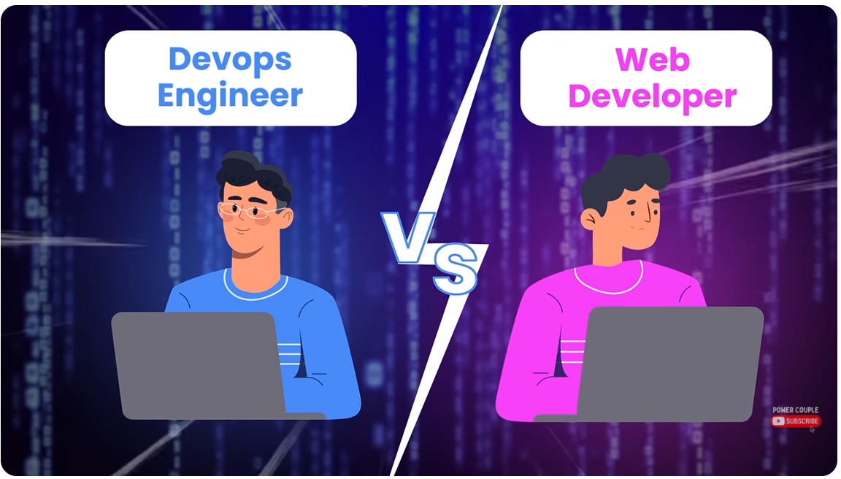
Week 5 Pre-Class Video
YouTube Video:
Top 5 high paying tech skills for 2024:
https://www.youtube.com/watch?v=RmE8FFTk0L8

Slide 49
Week 5 Pre-Class Video
Key messages from the pre-class video
The video explains that some less popular IT skills can lead to higher-paying jobs because fewer people know them and companies still need them.
1. Do not choose a skill only because it is popular
Web development is popular, but many people learn it. When many people have the same skill, employers may pay less.

Slide 50
Week 5 Pre-Class Video
2. Supply and demand matter
If a skill is needed by companies but fewer people know it, that skill can become more valuable.

Slide 51
Week 5 Pre-Class Video
3. Five high-paying tech skills mentioned
Skill | Simple meaning | Related jobs
Go programming | A simple but powerful programming language | Backend developer, cloud engineer
Rust | A fast and safe programming language | Systems developer, game developer
Docker & Kubernetes | Tools for packaging, running, and managing apps | DevOps engineer
Cloud platforms | Services like AWS, Azure, and Google Cloud | Cloud engineer
MapReduce / Hadoop | Tools for processing very large data | Data engineer

Slide 52
Week 5 Pre-Class Video
4. Docker is like a portable kitchen
Docker packages an app with everything it needs, so it can run the same way on different computers.
5. Kubernetes manages many containers
Kubernetes helps run, restart, scale, and update applications automatically.

Slide 53
Week 5 Pre-Class Video
6. Cloud skills are very important
Modern companies use cloud services to host apps, store data, and manage systems.
7. MapReduce is useful for big data
It breaks a huge task into smaller parts, processes them separately, then combines the results.

Slide 54
Week 5 Pre-Class Video
8. Main lesson
Students should explore modern IT skills such as cloud, DevOps, AI, and data engineering because these skills are highly relevant to industry projects and future employment.

Slide 55
Pre-Class Discussion
When prepping for a tech job, how do soft skills rank relative to tech skills?
Soft skills are very important, almost as important as technical skills.
Technical skills help you do the job (like coding or using tools). Soft skills help you work well with others and solve problems.

Slide 56
Pre-Class Discussion
For example:
Communication helps you explain ideas clearly
Teamwork helps you work with others
Problem-solving helps you handle challenges
Many employers say: Even if someone is very technical, they may not get hired if they cannot communicate or work in a team.

Slide 57
Pre-Class Discussion
Simple idea:
Technical skills = get the job
Soft skills = keep the job and grow in your career

Slide 58
Pre-Class Discussion
Why do some tech skills pay more than others?
Answer: Because of supply and demand. If fewer people know a skill but companies need it, the salary becomes higher.

Slide 59
Pre-Class Discussion
Should you only choose a career based on salary?
Answer: No. You should also think about your interest, background, and how easy the skill is for you to learn.

Slide 60
Pre-Class Discussion
What is Go programming language? Why is it useful?
Answer: Go is a simple and fast programming language. It is useful for building web services and cloud applications.

Slide 61
Pre-Class Discussion
What is Docker in simple terms?
Answer: Docker is like a box that packages an app with everything it needs, so it can run anywhere without problems.

Slide 62
Pre-Class Discussion
What does Kubernetes do?
Answer: Kubernetes manages many applications. It can restart them, scale them, and keep them running smoothly.

Slide 63
Pre-Class Discussion
Why are cloud skills important today?
Answer: Because most companies use cloud services (like AWS or Azure) to run their systems and store data.

Slide 64
Pre-Class Discussion
What is MapReduce used for?
Answer: It is used to process large amounts of data by breaking the work into smaller parts and combining the results.

Slide 65
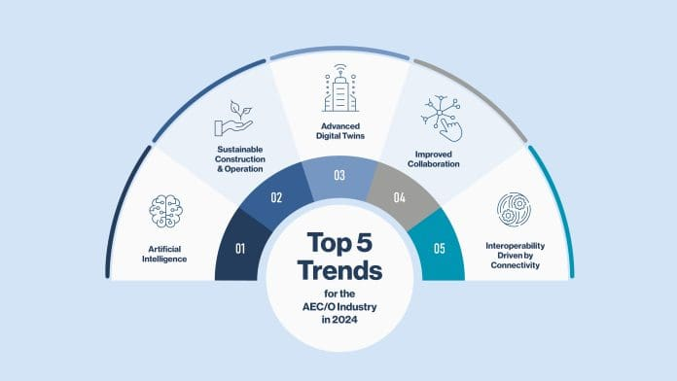
IT Industry Needs and Trends

Slide 66
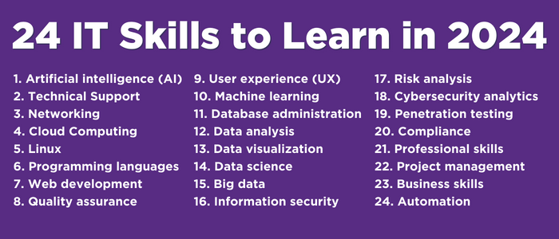
IT Industry Needs and Trends (Cont.)

Slide 67
IT Industry Needs and Trends: Artificial Intelligence
AI in the IT Project Design Phase
Streamlining workflows and aiding complex decision-making.
Enhancing creative processes and optimising designs for efficiency and sustainability through generative AI (GenAI).
AI in Construction
Managing logistics, quality control, and task automation.
Mitigating labor shortages, improving safety, and minimising errors and delays.
AI in Operation
Analysing performance data for energy efficiency and predictive maintenance.
Optimising facility management for sustainable and functional buildings.

Slide 68
IT Industry Needs and Trends: Sustainable Construction & Operation
Introduction to Sustainable Practices
Pressure to decarbonise and the industry's shift towards sustainability.
Digital tools as enablers for advanced sustainable practices in 2024.
Smart Building Technologies
Use of AI and sensors for optimising energy use and managing building climates.
Cloud-based platforms for resource monitoring, particularly water.
Eco-Friendly Materials and BIM
Integrating environmentally conscious materials with BIM for precise planning and resource efficiency.
Modern construction methods like prefabrication to minimise waste and emissions.
Role of Digital Modelling
Supporting sustainability goals through digital modelling and management.
Enhancing efficiency and environmental impact assessment.

Slide 69
IT Industry Needs and Trends: Advanced Digital Twins, Collaboration, and Interoperability
Advanced Digital Twins
AI-driven analytics, AR/VR integration, and immersive experiences for building performance and lifecycle management.
AR/VR and Improved Collaboration
Cloud technology's role in real-time project data sharing and management.
AR/VR enhancing stakeholder engagement, design reviews, and decision-making.
Technological Integration
VR's emergence as a design and engineering tool, enhanced by AI for realistic simulations and remote walkthroughs.
Streamlining collaboration and fostering creative project development.
Interoperability and Connectivity
Integration of BIM with digital twins, AI, IoT sensors, and cloud computing.
Centralising building data for informed decision-making and efficient project delivery.

Slide 70
Introduction to IT Project Skills
Core Technical Skills
Programming Languages: Proficiency in languages like Python, Java, and JavaScript.
Database Management: Skills in SQL, NoSQL databases, and data modelling.
Web Development: Understanding of HTML/CSS, frameworks like React or Angular.
Cloud Computing: Knowledge of platforms like AWS, Azure, or Google Cloud.
Networking: Understanding network protocols, security, and configurations.

Slide 71
Introduction to IT Project Skills (Cont.)
Soft Skills
Communication: Effective communication with team members, stakeholders, and clients.
Problem-Solving: Critical thinking and analytical skills to solve complex issues.
Time Management: Efficiently managing deadlines and project timelines.
Adaptability: Flexibility to adapt to changing project requirements and technologies.
Collaboration: Working effectively in cross-functional teams and fostering teamwork.

Slide 72
Introduction to IT Project Skills (Cont.)
Project Management Skills
Agile Methodologies: Knowledge of Agile frameworks like Scrum or Kanban.
Waterfall Methodology: Understanding traditional project management approaches.
Risk Management: Identifying and mitigating risks throughout the project lifecycle.
Budgeting and Resource Allocation: Skills in managing project budgets and resources effectively.
Stakeholder Management: Building relationships and managing expectations with stakeholders.

Slide 73
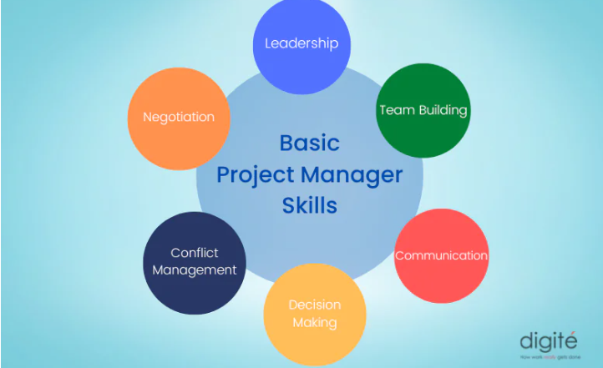
Introduction to IT Project Skills (Cont.)

Slide 74
Introduction to IT Project Skills (Cont.)
Quality Assurance and Testing Skills
Testing Strategies: Implementing test-driven development (TDD) and automated testing.
Quality Control: Ensuring software quality through rigorous testing and validation.
User Acceptance Testing (UAT): Collaborating with end-users to validate system functionality.
Deployment and Maintenance: Skills in deploying software updates and maintaining system performance.

Slide 75
Introduction to IT Project Skills (Cont.)
Assurance and Testing Skills
Emerging Technologies:
Artificial Intelligence and Machine Learning: Integrating AI/ML into project solutions.
Blockchain: Understanding blockchain technology for secure transactions and data management.
Internet of Things (IoT): Implementing IoT devices and leveraging data for insights.
Cybersecurity: Ensuring robust security measures in IT projects to protect data and systems.

Slide 76
Introduction to IT Project Skills (Cont.)
Assurance and Testing Skills(cont.)
Data Analytics and Visualisation
Data Mining: Extracting meaningful insights from large datasets.
Data Visualisation: Communicating data insights effectively using tools like Tableau or Power BI.
Predictive Analytics: Utilising statistical models and machine learning for predictive insights.
Business Intelligence: Analysing data to support strategic decision-making in organisations.

Slide 77
Introduction to IT Project Skills (Cont.)
Future Directions
Ethical AI: Integrating ethical considerations into AI development and deployment.
DevOps: Emphasising collaboration between development and operations teams.
Cloud-native Technologies: Harnessing the full potential of cloud computing for scalability and efficiency.
Remote Work and Collaboration Tools: Adopting tools and practices for effective remote project management.

Slide 78
Tools for Developing Sustainable Solutions
Lifecycle Assessment (LCA): LCA is a method for evaluating the environmental impacts of a product or service throughout its lifecycle, from raw material extraction to disposal.
Energy Management Systems (EMS): EMS tools for monitoring and optimising energy use in IT infrastructure and operations to improve efficiency and reduce carbon footprint.
Green Building Design Tools: Software tools used in architecture and construction for designing energy-efficient buildings that minimise environmental impact.

Slide 79
Technologies for Sustainable Solutions
Renewable Energy Technologies: Technologies such as solar panels, wind turbines, and geothermal systems used to generate renewable energy and reduce reliance on fossil fuels.
IoT (Internet of Things) for Smart Environmental Monitoring: IoT devices and sensors are used to monitor environmental parameters like air quality, water usage, and energy consumption to optimise resource usage.
Circular Economy Technologies: Technologies that support the principles of a circular economy, such as recycling technologies for e-waste and sustainable materials for manufacturing.

Slide 80
Understanding Patents in IT Projects
Patents:
Patents protect inventions and innovations, granting exclusive rights to inventors. They are crucial for safeguarding intellectual property.
Claims Analysis:
Involves scrutinising patent claims to decipher the specific features and functionalities that are protected. This analysis guides IT project teams in understanding what aspects of their innovations could potentially infringe on existing patents.
Impact on IT Landscape:
Patents shape the competitive dynamics within the IT industry by influencing product development strategies, dictating licensing terms for using patented technologies, and impacting market positioning through exclusivity rights.

Slide 81
Understanding Patents in IT Projects (Cont.)
Importance in IT:
Essential for safeguarding investments in research and development, fostering innovation by providing incentives for new ideas, and establishing market dominance through legal protection.
Role in Project Development:
Integral to guiding the direction of IT projects by outlining boundaries for innovation, influencing technological choices based on patent landscapes, and ensuring compliance with intellectual property laws to mitigate legal risks.

Slide 82
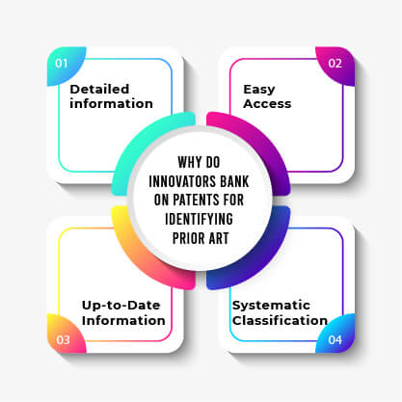
Understanding Patents and Prior Art

Slide 83
Understanding Prior Art in IT Projects (Cont.)
Prior Art Searches:
Conduct comprehensive searches across patent databases and scientific literature to identify prior art—existing technologies or solutions that may invalidate a patent claim or inspire alternative approaches in IT projects.
Search Methods:
Utilise comprehensive strategies such as exploring patent databases (e.g., USPTO, WIPO), reviewing scientific literature, attending conferences, and leveraging online repositories.
Evaluation Criteria:
Assess the relevance of prior art based on its similarity to the proposed innovation, temporal proximity, technological impact, and applicability to the project's objectives.

Slide 84
Understanding Prior Art in IT Projects (Cont.)
Importance in IT:
Essential for safeguarding investments in research and development, fostering innovation by providing incentives for new ideas, and establishing market dominance through legal protection.
Role in Project Development:
Integral to guiding the direction of IT projects by outlining boundaries for innovation, influencing technological choices based on patent landscapes, and ensuring compliance with intellectual property laws to mitigate legal risks.

Slide 85
Group Discussion Case Study
Scenario: Tools and Technologies for Developing Sustainable Solutions
You are leading a green technology initiative to develop smart city solutions. The project aims to integrate IoT and AI technologies to enhance urban sustainability.

Slide 86
Group Discussion Case Study
1. What are examples of IoT applications for smart city solutions?
- Smart traffic lights that reduce traffic jams
- Smart parking systems that show free parking spaces
- Sensors for air quality monitoring
- Smart waste bins that tell when they are full
These devices collect real-time data to improve city services.

Slide 87
Group Discussion Case Study
2. How can AI contribute to sustainable urban development?
- AI can reduce traffic by finding the best routes
- It can save energy by controlling lighting and electricity use
- It can predict problems (like system failures or pollution levels)
AI helps make better and faster decisions.

Slide 88
Group Discussion Case Study
What role does data analytics play in sustainable solutions?
- It helps understand large amounts of data from sensors
- It finds patterns (like peak traffic times)
- It supports better planning and decision-making
Data analytics turns data into useful insights for improving the city.

Slide 89
Case Study: Discussion Points
What are examples of IoT applications for smart city solutions?
Smart energy grids for optimising energy distribution and consumption.
Intelligent traffic management systems to reduce congestion and emissions.
Environmental sensors for monitoring air quality and water usage.
How can AI contribute to sustainable urban development?
Predictive analytics for efficient resource management and waste reduction.
AI-driven optimisation of public transportation routes and schedules.
Smart building technologies for energy-efficient infrastructure.
What role does data analytics play in sustainable solutions?
Analysing large datasets to identify trends and patterns for informed decision-making.
Monitoring environmental impacts and performance metrics of sustainable initiatives.
Providing actionable insights for continuous improvement and innovation.

Slide 90
Summary
Understanding industry needs and trends in 2024.
Identifying key skills and capabilities required in IT projects.
Tools and technologies for developing sustainable solutions.
Integration of AI in various sectors for efficiency and innovation.
Case studies on successful implementation of sustainable practices.

Slide 91
Q&A
Question?

Slide 92
Week 5 Workshop :
Skills and Capabilities in IT Projects
ICT502
ICT502 Applied IT Project A
92

Slide 93

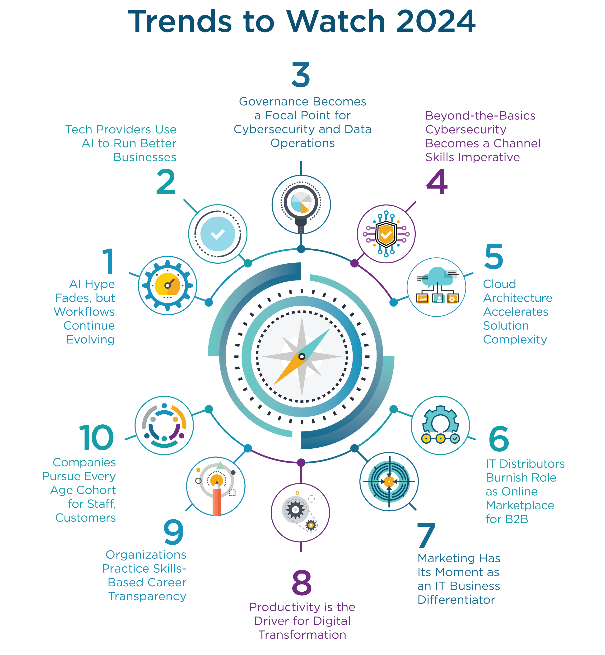
IT industry needs and trends in 2024

Slide 94
Summary of IT industry needs and trends
Increased adoption of AI and machine learning across industries.
Emphasis on cybersecurity measures and data privacy.
Growth in cloud computing solutions and hybrid IT infrastructures.
Expansion of IoT applications in smart cities and industrial sectors.
Demand for professionals skilled in blockchain technology.
Focus on sustainability and green IT practices.

Slide 95
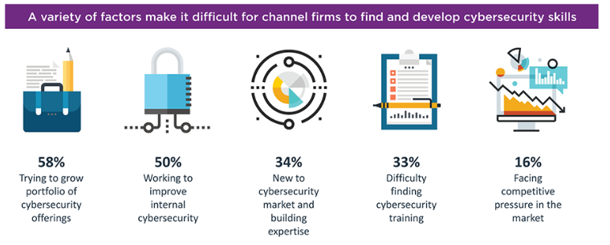
Challenges: Building Cybersecurity Skills

Slide 96
Video: Building Cybersecurity Skills
Do you have what it takes to get into Cybersecurity in 2024?
Watch this video to learn :
https://www.youtube.com/watch?v=MuSIys2AOzw
1. Cyber security is not easy
Many people think it is easy, but it is actually hard to learn because you need to understand many things like computers, networks, and systems.

Slide 97
Video: Building Cybersecurity Skills
Do you have what it takes to get into Cybersecurity in 2024?
Watch this video to learn :
https://www.youtube.com/watch?v=MuSIys2AOzw
2. You usually don’t start directly in cyber security
Most people begin with basic IT jobs (like help desk) to learn fundamentals first.

Slide 98
Video: Building Cybersecurity Skills
Do you have what it takes to get into Cybersecurity in 2024?
Watch this video to learn :
https://www.youtube.com/watch?v=MuSIys2AOzw
3. You need strong basic knowledge
You must understand:
- How computers work
- How networks work
- How systems are secured
Without this, cyber security will be very difficult.

Slide 99
Video: Building Cybersecurity Skills
Do you have what it takes to get into Cybersecurity in 2024?
Watch this video to learn :
https://www.youtube.com/watch?v=MuSIys2AOzw
4. There are different roles
- Blue team (defenders) → protect systems (most beginners start here)
- Red team (hackers/testers) → test security (not entry-level)

Slide 100
Video: Building Cybersecurity Skills
Do you have what it takes to get into Cybersecurity in 2024?
Watch this video to learn :
https://www.youtube.com/watch?v=MuSIys2AOzw
5. The job can be stressful
Sometimes there are many alerts and problems, which can cause pressure and burnout.

Slide 101
Video: Building Cybersecurity Skills
Do you have what it takes to get into Cybersecurity in 2024?
Watch this video to learn :
https://www.youtube.com/watch?v=MuSIys2AOzw
6. Cyber security is getting harder
New technologies like AI and deepfakes make attacks more advanced and harder to stop.

Slide 102
Video: Building Cybersecurity Skills
Do you have what it takes to get into Cybersecurity in 2024?
Watch this video to learn :
https://www.youtube.com/watch?v=MuSIys2AOzw
7. You need curiosity and passion
You should:
- Ask questions
- Research problems
- Want to learn more on your own
Curious people succeed more.

Slide 103
Video: Building Cybersecurity Skills
Do you have what it takes to get into Cybersecurity in 2024?
Watch this video to learn :
https://www.youtube.com/watch?v=MuSIys2AOzw
8. You must keep learning
Technology changes fast, so you need to:
- Learn new tools
- Follow cyber security news
- Improve your skills continuously

Slide 104
Video: Building Cybersecurity Skills
Do you have what it takes to get into Cybersecurity in 2024?
Watch this video to learn :
https://www.youtube.com/watch?v=MuSIys2AOzw
9. You need technical skills
Basic skills include:
- Networking
- Security systems
- Some coding (Python, SQL)

Slide 105
Video: Building Cybersecurity Skills
Do you have what it takes to get into Cybersecurity in 2024?
Watch this video to learn :
https://www.youtube.com/watch?v=MuSIys2AOzw
10. Hard work (grind) is required
At the beginning, you must:
- Study regularly
- Practice daily
- Spend extra time learning

Slide 106
Video: Building Cybersecurity Skills
Do you have what it takes to get into Cybersecurity in 2024?
Watch this video to learn :
https://www.youtube.com/watch?v=MuSIys2AOzw
11. Practice is very important
You should:
- Use tools like Splunk
- Build your own projects (home lab)
This helps you gain real experience.

Slide 107
Video: Building Cybersecurity Skills
Do you have what it takes to get into Cybersecurity in 2024?
Watch this video to learn :
https://www.youtube.com/watch?v=MuSIys2AOzw
12. Final message
Cyber security is challenging but rewarding. If you are willing to learn, work hard, and stay curious, you can succeed.

Slide 108
Dear Dr. Farshid,
Thank you so much for your helpful reply and guidance. I really appreciate your time and support.
I would be very grateful if you could share a detailed cybersecurity roadmap tailored to my current level. I am currently studying Bachelor of Information Technology at ACU, and I have completed a Microsoft Excel certification. However, I would like to start cybersecurity from the zero/basic level and follow a clear step-by-step roadmap from now.

Slide 109
I would also really appreciate your advice on how I should prepare from now if I want to pursue a Master’s degree with a fully funded or 50% scholarship in the future. I am currently studying my Bachelor’s degree at ACU with a 50% scholarship, and I would like to continue my Master’s study with a scholarship as well. It would be very helpful if you could guide me on what skills, certifications, academic results, projects, or other activities I should focus on from now.
Thank you again for your time, support, and guidance.
Kind regards,

Slide 110
Dear Zihad,
Thank you for your email — I’m very pleased to see your motivation and clear goals.
Based on where you are now, I would suggest taking a gradual and structured approach rather than trying to learn everything at once.

Slide 111
To begin with, focus on building your fundamentals over the next few months. Make sure you are comfortable with how computers and operating systems work (Windows and some basic Linux), and then spend time understanding networking concepts such as TCP/IP, DNS, and how the internet functions. Certifications like CompTIA A+ and Network+ can help guide your learning at this stage. At the same time, try to do some simple hands-on exercises using platforms like TryHackMe.

Slide 112
Once you feel confident with the basics, you can move into core cybersecurity concepts. This includes understanding common threats, vulnerabilities, and basic security principles such as encryption. You can also start exploring tools like Wireshark and Nmap. CompTIA Security+ would be a good next step, and continuing hands-on practice will be very important.

Slide 113
After that, you can start developing more practical skills and think about which area interests you most (for example, SOC analysis, penetration testing, or cloud security). At this stage, learning some basic Python or SQL will be helpful, along with exposure to tools such as SIEM platforms (e.g., Splunk). I would also strongly encourage you to build small practical projects, such as a simple home lab or basic network monitoring setup.

Slide 114
Alongside your learning, try to build a small portfolio over time. Keep records of what you do, upload projects to GitHub, and if possible, participate in beginner Capture The Flag (CTF) challenges. These experiences will be very valuable when applying for internships or entry-level roles such as IT support or help desk.

Slide 115
Regarding your goal of continuing to a Master’s degree with a scholarship, there are a few key areas to focus on:
Maintain a strong academic performance (aim for Distinction or above where possible)
Develop practical technical skills, not just theoretical knowledge
Complete relevant certifications gradually
Build a clear portfolio of projects

Slide 116
Get involved in university activities, competitions, or research if opportunities arise
Continue developing your communication and teamwork skills
These factors are usually considered together when scholarships are awarded.

Slide 117
Overall, the key is consistency. Even a small amount of focused study each day will make a difference over time.
You may also find it useful to watch a short introductory video on cybersecurity careers. It highlights some important realities of the field — particularly the need for strong fundamentals, continuous learning, and hands-on practice.

Slide 118
I’m happy to share the link if you’re interested.
https://www.youtube.com/watch?v=MuSIys2AOzw
Feel free to reach out if you need further clarification. We can also arrange a time later in the semester to discuss your progress if that would be helpful.

Slide 119
Workshop Activity 1
Scenario 1: Ransomware Attack
Scenario: During an IT project, a sophisticated ransomware attack infiltrates the project's network, encrypting critical project data stored on servers. The attackers demand a ransom payment in exchange for decrypting the data..
Discuss in your groups:
Why is cybersecurity important in IT projects?
How can proactive cybersecurity measures mitigate the impact of ransomware on IT projects?
As a project manager, what should you do to prevent cyber attacks during your project implementation?

Slide 120
Workshop Activity 2
Scenario 2: Data Breach Incident
Scenario: During an IT project involving sensitive client data, a data breach occurs due to a vulnerability in the project's database security. Unauthorised individuals gain access to client information, including personal details and transaction histories.
Discuss in your groups:
Why is cybersecurity crucial in protecting project data from breaches?
How can a data breach impact the success and credibility of IT projects?
Why is it important for IT projects to conduct regular security audits and vulnerability assessments?

Slide 121
Workshop Activity 3: Open Questions
Discuss in your group with the help of an online search platform:
How do you prioritise and manage technical and non-technical skills in a project team?
How do you foster effective communication among team members and stakeholders?
Can you describe a situation where adapting to new technologies or methodologies was crucial in achieving project objectives?
How important is it for IT project managers to understand the business context and goals of their projects?
How does prioritising cybersecurity contribute to the overall success and sustainability of IT projects?

Slide 122
Workshop Activity 4: Infographic summary
◆ Students are required to list the concepts that have been covered in the reading materials and lecture and group them by their category.
◆ Use an online tool (such as https://www.canva.com/ ) to produce the infographic summary to be submitted and present to the class.

